Slide 1
Topics
Linear Regression
Gradient Descent
Regularization

Slide 2
Linear Regression
Regression or Classification
Supervised or Unsupervised
Linear – coefficients have power of 1
Regression – predict a number
Output = Weighted sum of inputs + Constant
Rent = w1 * Area + w2 * Years + C
w1 and w2 are called coefficients or parameters

Slide 3
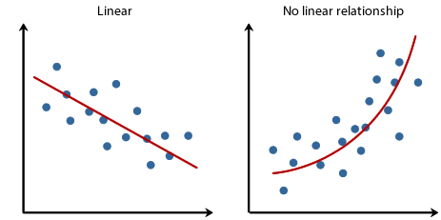
Underlying Relationship

Slide 4
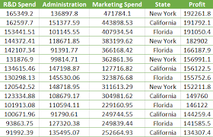
Types
Number of explanatory variables
Simple Linear Regression
Multiple Linear Regression
Polynomial Linear Regression
Number of target variables
Univariate
Multivariate

Slide 5
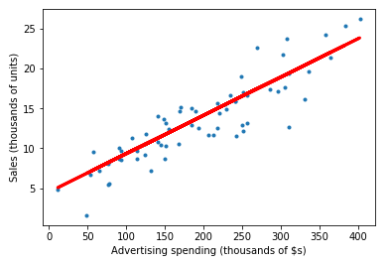

Simple Linear Regression
One Predictor X
One Response Y

Slide 6
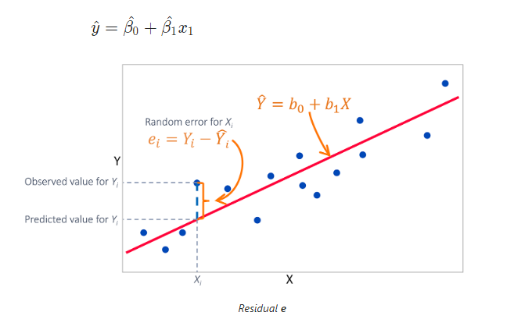

Calculate accuracy of y – Cost Function

Slide 7
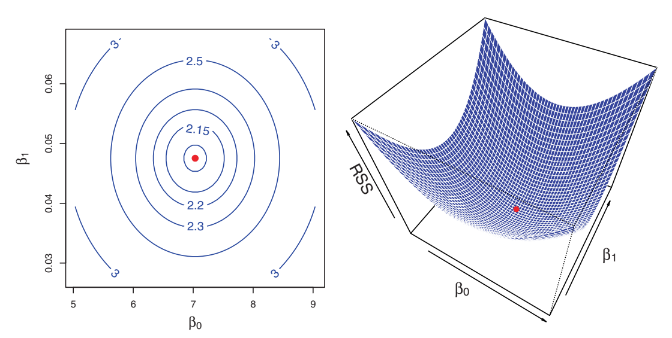

Slide 8
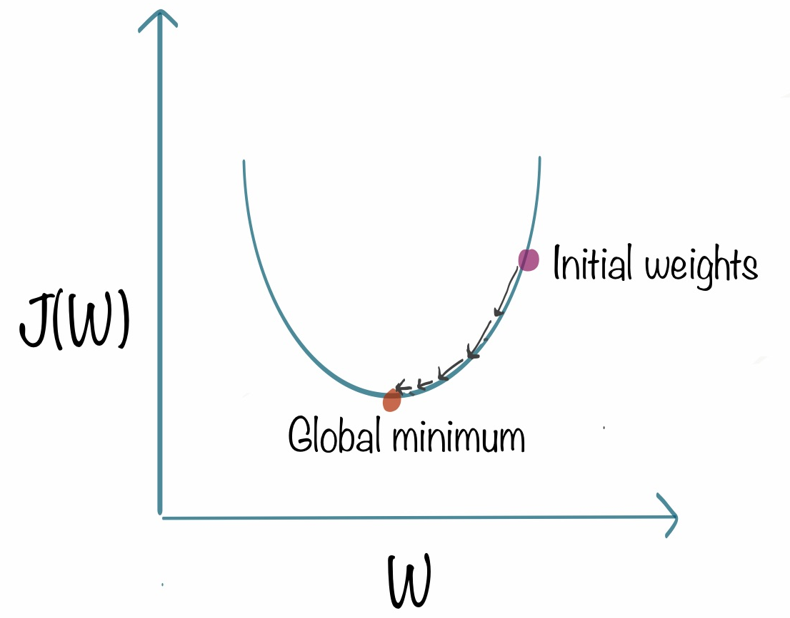
Training – Finding parameters
Gradient Descent
Randomly initialize all parameters w
Change parameters w iteratively to minimize a cost function
Calculate slope at a point
Take small step in that direction

Slide 9
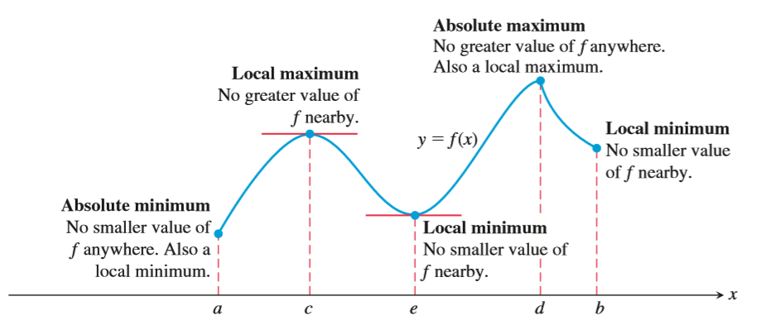

Slide 10
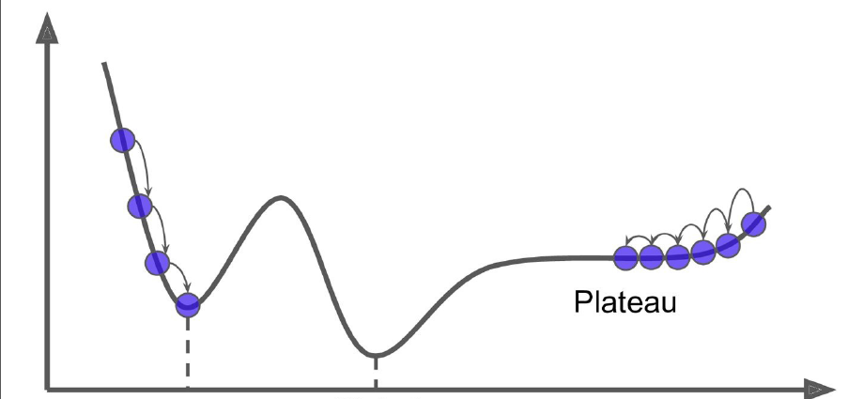

Slide 11
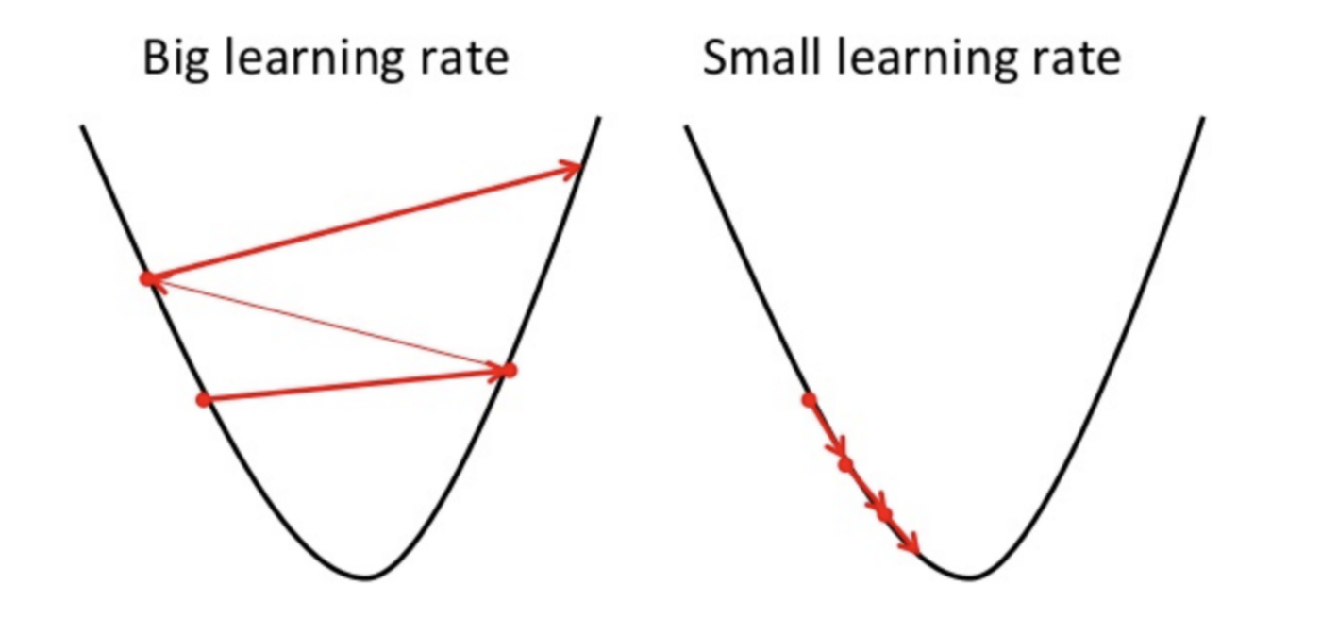
Learning rate
Too large
Too small

Slide 12
Types of Gradient Descent
Batch Gradient Descent
Stochastic Gradient Descent
Mini Batch Gradient Descent
No of examples used to calculate in Cost function

Slide 13
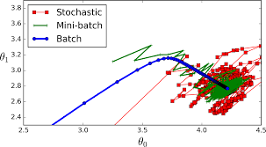

Slide 14
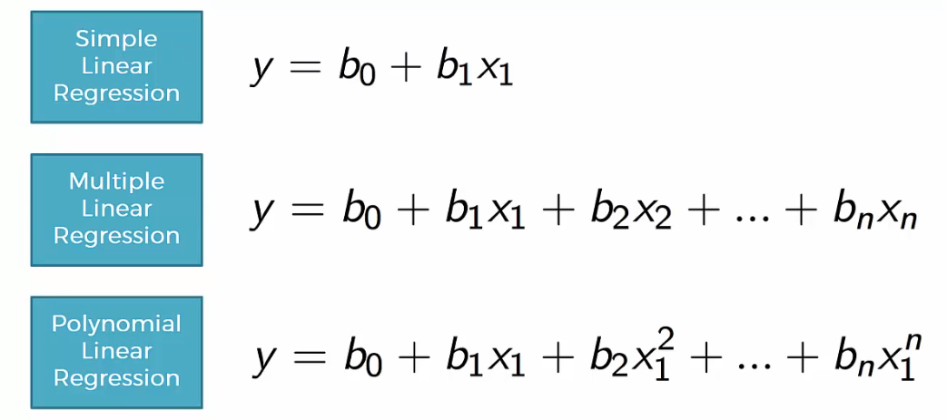
Linear Regression Models

Slide 15
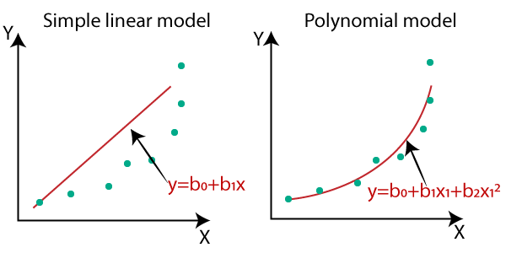
Polynomial Linear Regression

Slide 16
Regularization
Technique to prevent overfitting
Types
Explicit regularization
Add penalty term
Implicit
Examples
L1 Regularization
L2 Regularization
Early Stopping

Slide 17
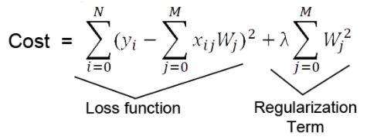
Explicit Regularization
Large coefficients cause Overfitting
Types
L1 Regularization
absolute sum of all coefficients
L2 Regularization
sum of squares all coefficients

Slide 18
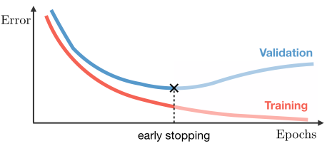
Implicit Regularization
Example
Early Stopping
Learning Curve
Plot of model learning performance over experience or time
Loss over iterations
Determine underfit or overfit

